Slide 1
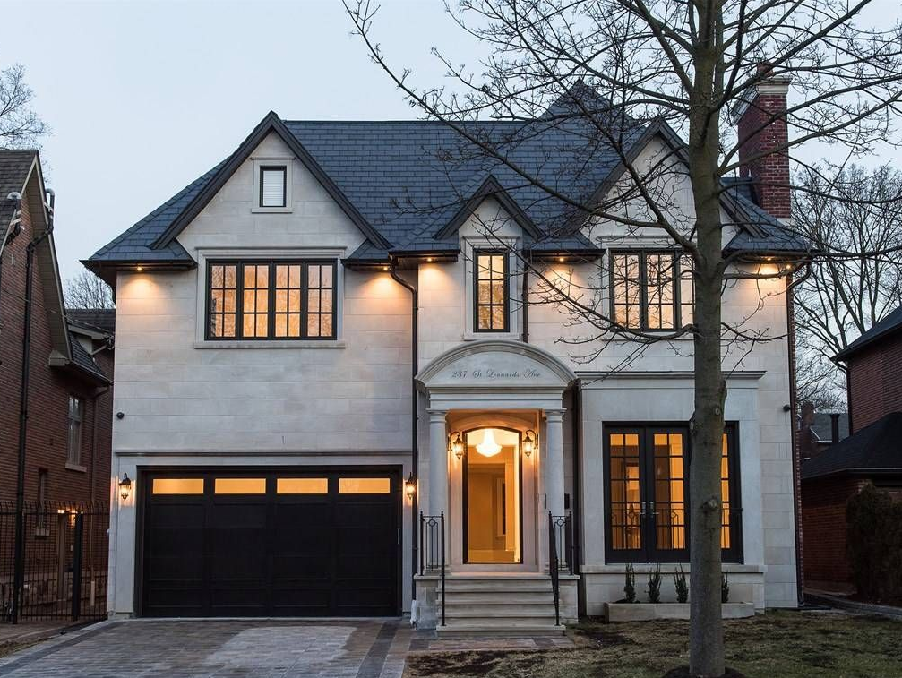
Strategic Marketing Plan
Keller Williams Neighbourhood Realty
By: Yi-Ting Chung, Meixuan He, Van-Anh Le, Hailey Liscio, Sabrina Medeiros, Alice Oprea, Jordyn Read
Notes:
Start will polls to engage the audience and spark a conversation that we can include in our presentation
- Officially introduce Keller Williams & their current standings (THE WINDUP)
- Discuss the environment they exist in:
- External and internal issues
- From this analysis we move to the next point
- Introduce the problems we found (THE HURDLE)
- Break down marketing plan (THE VISION & THE OPTIONS)
NOTES :
Emily view: not to deliver information - inspire the clients and create a compelling case to execute
Need to be a call to action!

Slide 2

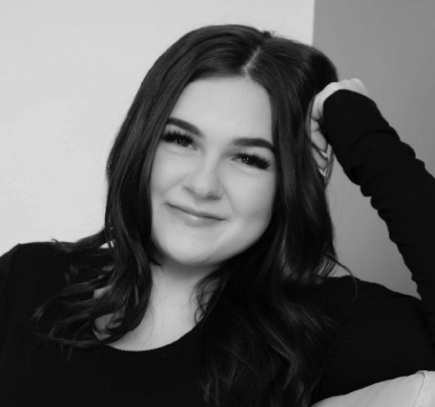
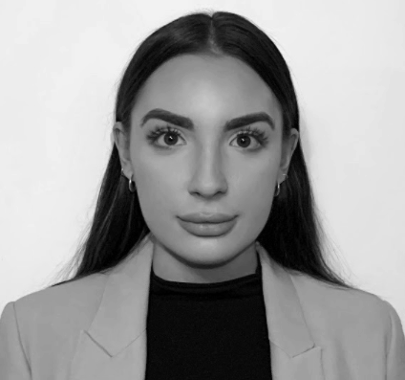
Our Team - Seventh Wonder Consulting Agency
Jordyn Read
Hailey Liscio
Alice Oprea
SCRUM Master and Account Director
Strategic Director
Brand Management Director

Slide 3

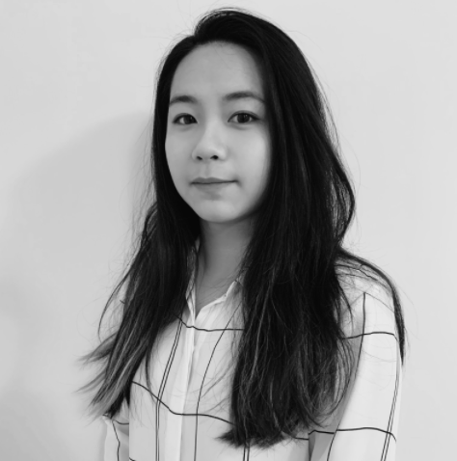

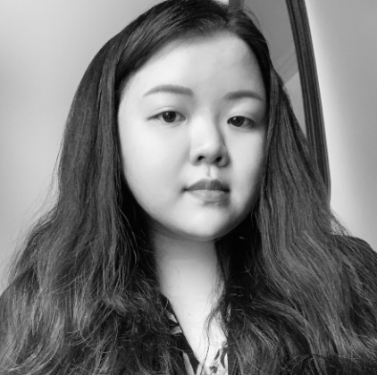
Sabrina Medeiros
Yi-Ting Chung (Sophie)
MeiXuan He (Coco)
Van-Anh Le (Anh)
Jordyn Read

Slide 4
1
2
3
4
5
6
Agenda
The Windup
The Hurdle
The Vision
Introduction to Keller Williams
Problem Statement
The Marketing Mix
The Options
The Close
The Fine Print
The IMC
Budget & Sales Forecast
Performance Measures, KPI’s, & Gantt Chart
Notes:
NOTE: Missing the hook if we want to add it

Slide 5
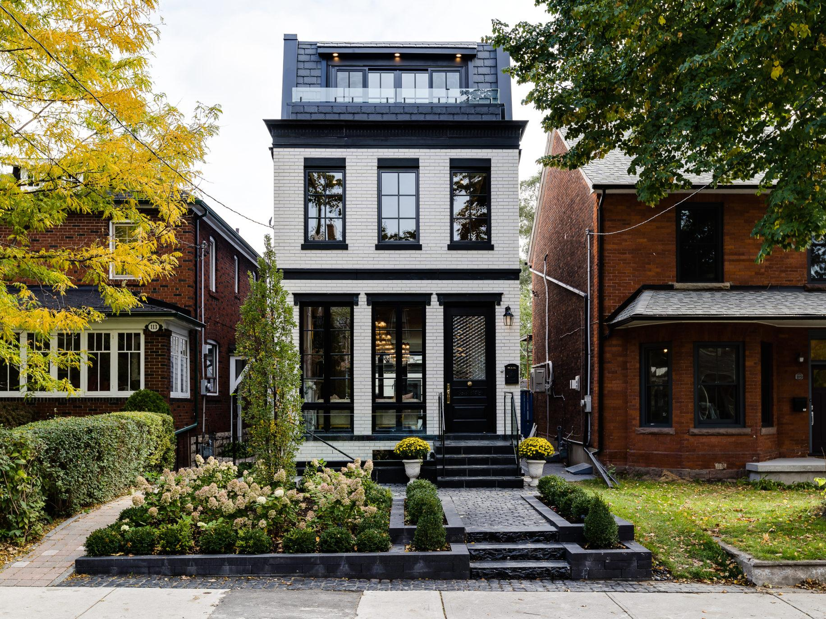
The Windup
01

Slide 6

Real Estate Done Right!
#1 training organization for 2015
New direction under the brave leadership of businessman Dylan Suitor
Empathetic approach to real estate!
Notes:
JORDYN
Keller Williams Neighbourhood Realty is a real estate office located in the Junction of West End Toronto. In 2020, Keller Williams brought in a revenue of $7 million dollars and saw roughly $1 million in profit. Keller Williams is currently under new management, by Dylan Suitor. By the end of 2021, they want to retain a growth of 159 agents, a gross of 107, and selling a minimum of $22.2 million. The ultimate goal is turning this small real estate office into one of the most popular real estate offices located in the West End of Toronto.
Emily Notes:
It should be more inspirational - selling them - not the facts - what is amazing about them - high growth? - try to win them over - Make the client feel good - make them believe we understand who they are - What do they think is amazing about themselves - Boosting their ego.
Na: focus on what makes them different and great
Yvonne Notes:
Boost about Dylan Suitor - during a pandemic he bought an agency

Slide 7
Lack of Marketing Strategy
KWNR needs to attract more agents
Internal Analysis
KWNR gives agents their own power and freedom on marketing.
KWNR focus is to support the agents but that’s a problem when occurring new talent.
Notes:
HAILEY
Thank you jordyn for that amazing introduction about Keller Williams next we will be moving on the internal analysis which is mainly the issues we have determine through research and conversations with our contact paige.
A issue Keller Williams does encounter is a lack of marketing strategy . This evident through the amount of social media follower have compared to their competition and their own agents. Keller Williams gives its agents their own power of doing their own marketing but this does not create a unified marketing strategy. The brokerage itself does not have advertisements. it main focus is to supports the agents but that's a problem when accruing talent, and customers. Keller Williams is growing at a fast pace and they must meet the demand of properties. No matter what is happening in the world like COVID_19 customer will continues to buy and sell homes. Keller williams needs their own marketing strategy in order to help their own agents grow and attract new clients.
Addd social
P7 internal- however it has challenges: need more agents, lack of marketing strategy - spend more time on lack of marketing strategy, why? How we came up with this
Lack of marketing strategy- unified marketing is non-existent, followers on social media, individual agents social media
Keller williams needs their own marketing strategy in order to help their own agents grow
Agents will only be as successful as KW is
Emily Notes:
Spelling error
Talk about their challenges
Make more clear
Na
Lack of marketing strategy
Why do we think this? (Paige interview, as well as comparing presence to competitors, what type of marketing strategy)

Slide 8
External Competitors of KWNR
What this means for KWNR
External Analysis
Re/Max West Realty Inc. Brokerage
Century 21 Fine Living Realty Inc.
Royal LePage Real Estate Services Ltd., Brokerage
Located in the Junction
Competing against established names
Notes:
ALICE
Emily Notes:
Add a SO WHAT - Some clients will pick competitors over KW
Some customers pick competitors cuz they have best history, #1 top of mind etc.
Keller williams fresh new company, has a fresher outlook, new training

Slide 9

The Hurdle
02

Slide 10
Problem Statement
Keller Williams Neighbourhood Realty focuses on their agents rather than first time home buyers. However, Keller Williams is competing against established brands. By implementing a marketing strategy, the short and long term goals of gaining more agents and building long lasting relationships with clients will be achieved.
Notes:
ALICE

Slide 11
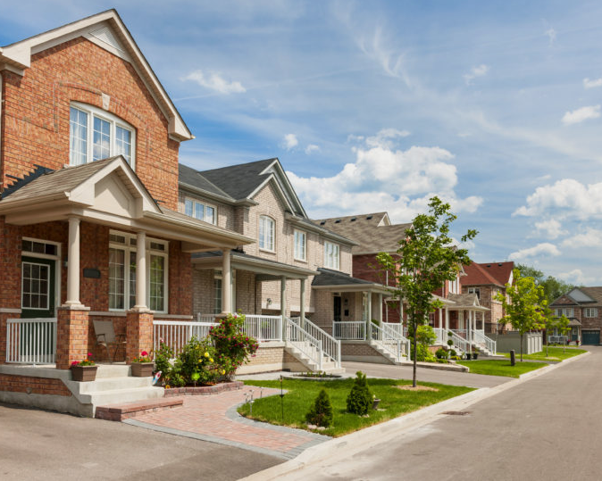
The Vision
03
Notes:
COCO

Slide 12
Strategic Objectives
In order to continue the success of Keller WIlliams Neighbourhood Realty, our marketing strategies will focus on:
Increase brand awareness by improving social media presence and website traffic
Expand the company’s market share by recruiting more skilled agents
Build relationships with first-time home buyers using public relations and CRM
Notes:
Na suggested order: problem, followed by methodology, how to solve problem, highlight what we are going to do. ***if we keep this slide last two pages would have this objective (because outcomes).
Attract agents, increase social media exposure
To understand out first time home buyers we have create a persona
Define clients & agents & end users

Slide 13
Finding the Perfect Fit
Profile
Frustrations
Age: 35
Status: Engaged
Location: Toronto, ON
Occupation: Head of HR
Renting Expenses
Downtown Traffic
Unskilled Realtors
First-time
Home buyers
Good Financial Investment
92%
Personality
Preferred Channels
Intention
68%
Extrovert
Traditional Ads
Financial Outlook
74%
Open-Minded
Social Media
Conscientious
Real Estate Resources
Referrals
47%
Adaptable
SEO & SEM
Notes:
According to our research, 92% of Ontarians agree that homeownership is a good financial investment and 80% of them intended to purchase a home within 2-5 years. Despite the economic challenges related to the pandemic, 74% of the first-time home buyers are confident in short-term personal financial outlook
When it comes to home buying, 47% of first-time home buyers use real estate resources. There is a 14% increase in the use of listing websites, and 7% more buyers have recognized the value of using real estate agents
Based on the segmentation analysis, we have determined first-time home buyers as our optimal target market. The customer persona we have for this targeted segment is the 35 years old lady living in Toronto. She has been renting her apartment in the Harbourfront area; however, renting expenses and downtown traffic really frustrate her. She is recently engaged and looking for a home to start a family, and being a first-time home buyer, she needs guidance from an experienced realtor that understands her needs and can help her find the perfect place.

Slide 14
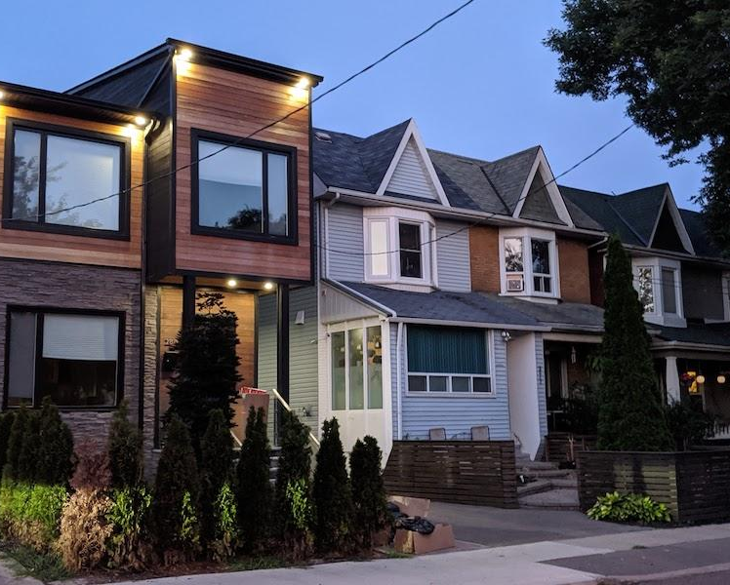
The Options
04
Notes:
ANH
Thank you Coco for an amazing target customer persona!
In our IMC plan, we want need to maximize all opportunities that would promote our client brand professionalism and brand awareness.
The plan will integrate various marketing activities and actions such as digital marketing tools to create ads for both customers attraction and recruitment.

Slide 15
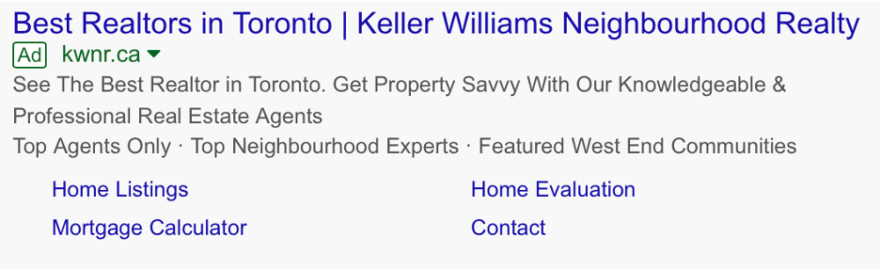
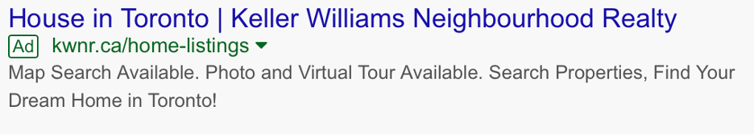
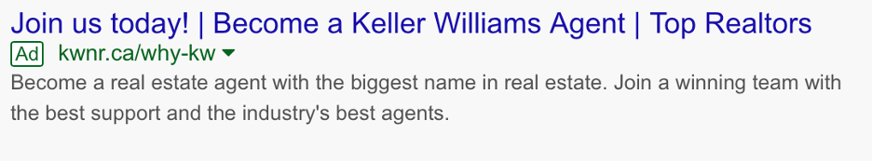
Increase Website Traffic
“97% of all home buyers search info using online websites”
Keywords
Recruit Agents
Google AdWords:
(National Association of Realtor)
“Townhouses in The Junction”
“detached house in Toronto”
“Toronto best bealtor”
“First home mortgages”
“The Junction realtor”
200 agents in 2 years
Notes:
ANH
Research from the National Association of Realtor showed that 97% of all home buyers search information using online websites when they first start their home searching process.
Therefore, the first step is to gain more reach and drive traffic to our client’s website. We believe that adwords should be one of the biggest focuses for our IMC plan.
We will focus on determining the best keywords that would match our customers' intention when they are on the first stage of their home buying process.
A few highly ranked keywords we would recommend are “townhouses in the Junction”, “Toronto best realtor”, “detached house in Toronto”, “first home mortgages”, “the Junction realtor”
We will first run a few trial campaigns to see how many people have potentially seen those ads and the demographic information on those users, including their general location.
Then, we will continue to monitor its results such as impressions, and other conversion rates to see if the return on ad spend meets our expectations.
In addition, we will also roll out AdWords campaigns that aim to recruit agents in order to reach our client’s human resources objectives.
The Google AdWords campaign will run throughout the year, with adjustment to each campaign's date and time according to the results of the previous campaigns.

Slide 16
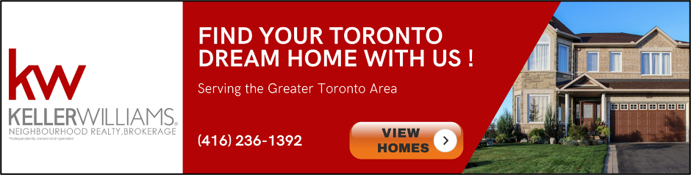
Web Banner Implementation
Increase brand recognition and awareness
Drive traffic to website & generate new leads
Break-Even Point
Call to Action
Catch Attention
Incorporate With
Duration
Jupiter is the biggest planet in the Solar System
“Find Your Dream Home”
“View Homes”
Visually Engaging Images & Bright Colors
Google Content Network AdWords Campaigns
4th quarter of 2021 - 1st quarter of 2022
Notes:
HAILEY
Our next action for the digital marketing strategies is Web Banner Advertisement. It is another cost-effective way to allow our clients to display our clients’ services on the Internet.
It allows us to increase the brand recognition and awareness, drive traffic to our client’s website, as well as generate new leads.
With this type of advertisement, it needs to have a strong call to action such as “Find your dream home”, “View homes” in order to catch the audience's attention, using visually engaging images and bright colors to make the ad clickable.
Once we are ready to roll out the banner ads, we would start with the Google Content Network so that it is incorporated with our AdWords campaigns, based on its optimal keywords and demographic.
The display ads campaigns will be roll out in the fourth quarter of this year, where the most listings go active online , until the end of the first quarter of the following year, which is when the greatest number of homes sold

Slide 17
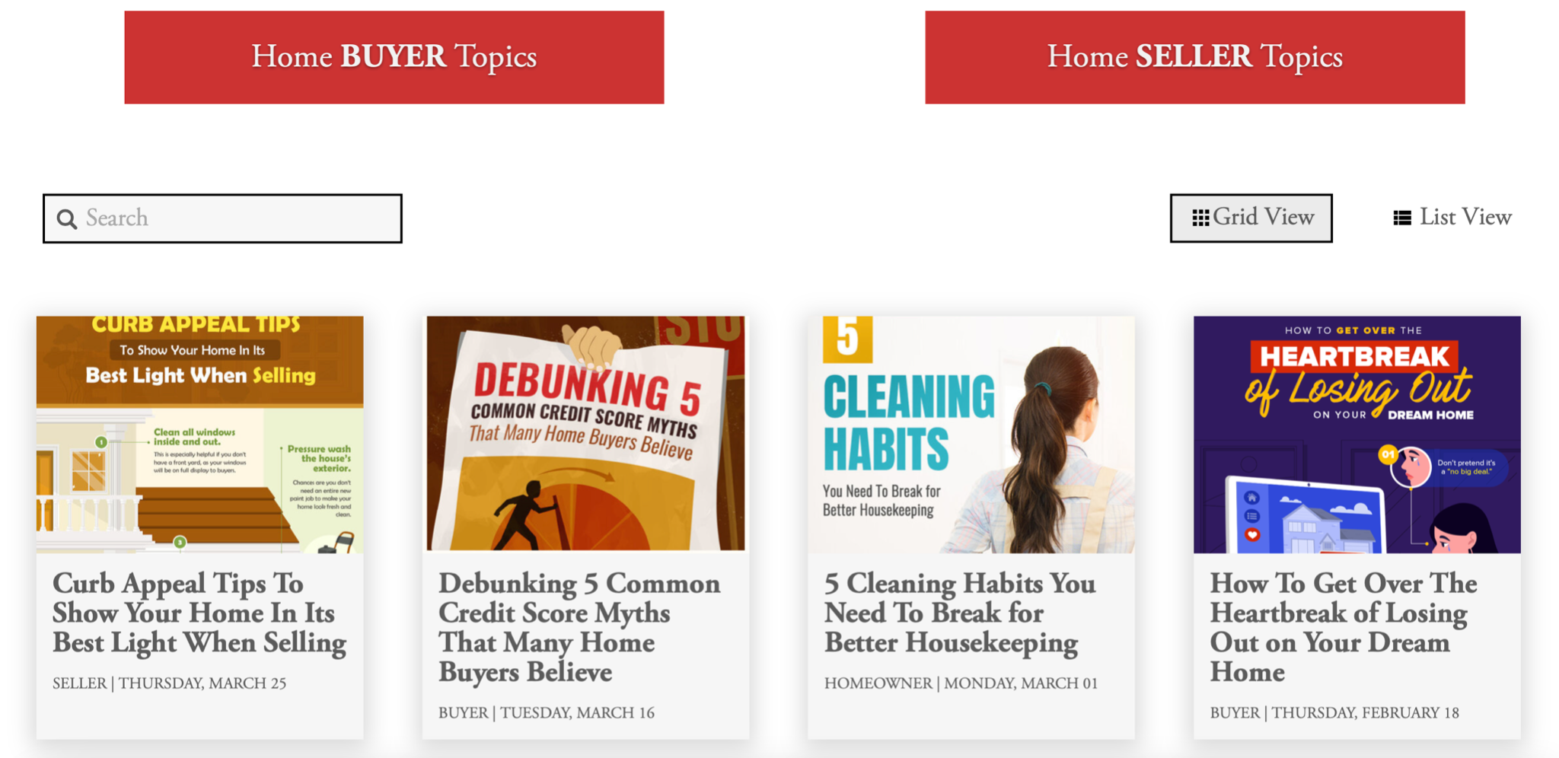

Optimize Website Contents
“Content marketing generated 434% more search engine results pages and resulted in 5 times as many sales lead”
Create & Update Blogs
“10 Things First-time Home Buyers Need To Know”
“5 Tips For Improve Credit Score”
“Why You Need a Realtor?”
“Exploring Types Of Mortgages”
“Toronto Real Estate: Condos Or Houses?”
Search Engine Optimization
Repurpose Content
Cycle content through different channels
`
(SEMrush)
Notes:
ANH
Another focus of our IMC is on content marketing to maximize our client’s SEO and SEM through the “BLOG” section on their website. As SEMrush reported that content marketing generated 434% more search engine results pages and resulted in 5 times as many sales lead.
Currently, KWNR has a Blog section on their website but there is no content posted, which is a huge miss out on website and business outreach opportunities.
We believe that creating and updating blogs for content marketing purposes will also increase brand awareness, generate more qualified leads as well as give them content to cross-share on social media.
We will start by forming a team of copywriters to produce content for our clients, while improving their search engine rankings and performance.
Next, the content team will create a content database that can be used for the repurpose strategy, which means that we will cycle the content through different channels such as social media and events. For example, a blog can be reposted on FB or turn to other visual content like video and infographic, meeting’s speaking topics can reproduce as a blog and vice versa.
We would expect to see content posted on our client’s blog section once or twice a month, and the content would be reproducing and repurposing after six to eight months.
Now, with the main focuses of our IMC planned, Sabrina is going to talk about how we will use Social Media and Public Relation Events to support those marketing efforts.

Slide 18
Why Social Media?
“77% of Millennials are active social media users”
“An average 3 hours per day, per person are spent on social networks and messaging”
Instagram
Company | Posts | Followers | Following
Keller Williams Neighbourhood Realty | 487 | 694 | 1268
Re/Max West Realty Inc. Brokerage | 383 | 652 | 269
Royal LePage Real Estate Services Ltd., Brokerage | 0 | 0 | 0
Century 21 Fine Living Realty Inc. | 0 | 0 | 0
(Emarketer)
Facebook
Company | Follows | Likes
Re/Max West Realty Inc. Brokerage | 2293 | 2109
Royal LePage Real Estate Services Ltd., Brokerage | 2081 | 1401
Keller Williams Neighbourhood Realty | 431 | 377
Century 21 Fine Living Realty Inc. | 117 | 111
(Globalwebindex)
Notes:
Social media is one of the greatest marketing tools that can help advance a company's brand awareness as well as be able to target their specific demographic
Here you can see where Keller Williams Neighbourhood Realty is performing in FB & INSTA based on their local competitors
Through the use of social media, according to Forbes - 71% of people who have had a positive experience with their brand are likely to recommended the brand to family and friends

Slide 19

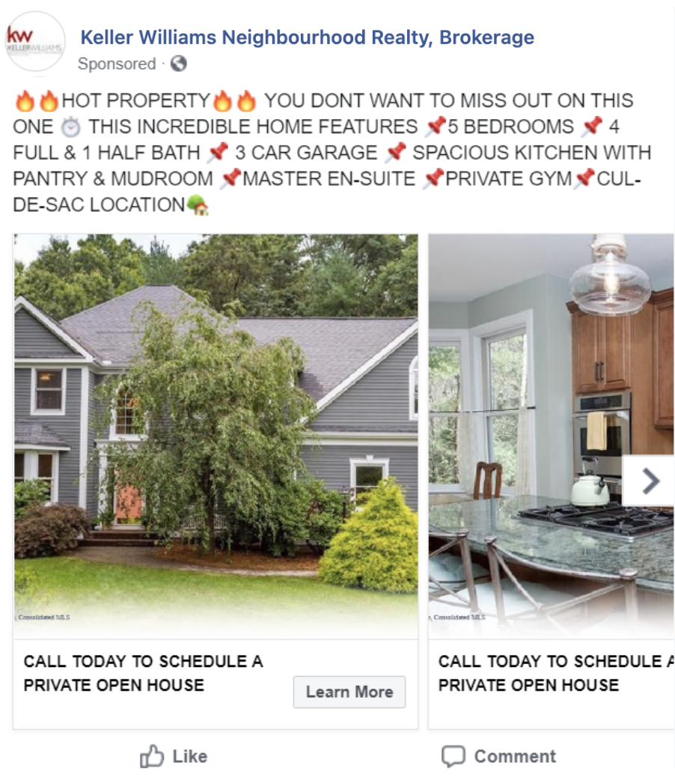
Facebook Marketing
“77% of social media users come from Facebook”
Targeted Audience
Basic
Listed Properties
Promote Webinars
(Canadian Internet Registration Authority)
First-Time Home Buyers
Notes:
When we dive deeper into the potentials of using Facebook, it is the top social media platform used.
As a company, you are able to generate a large amount of awareness and recognition based on creating posts, stories, and communicating with current and potential clientele
For this reason, our team wants to further the use of Facebook by regularly updating the account in order to grow our follower base and stay relevant:
We can create advertisements that promote agents, listings, and any additional information such as new blogs!

Slide 20
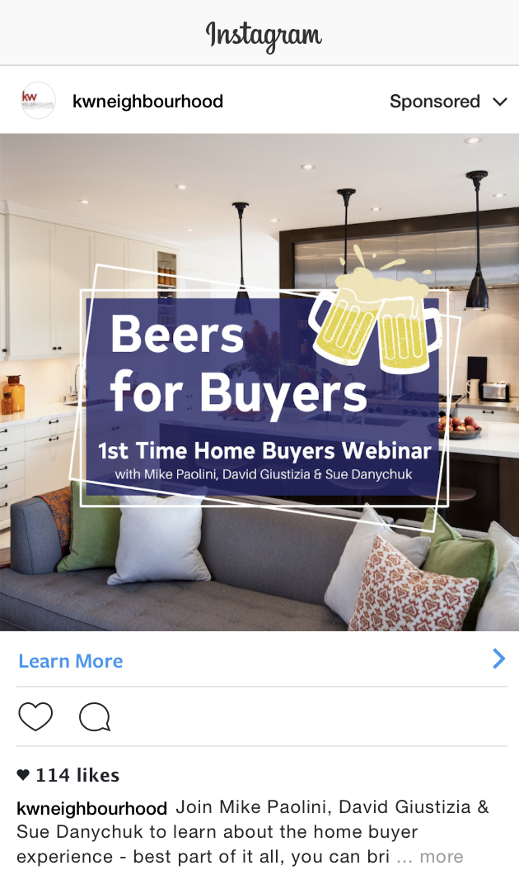
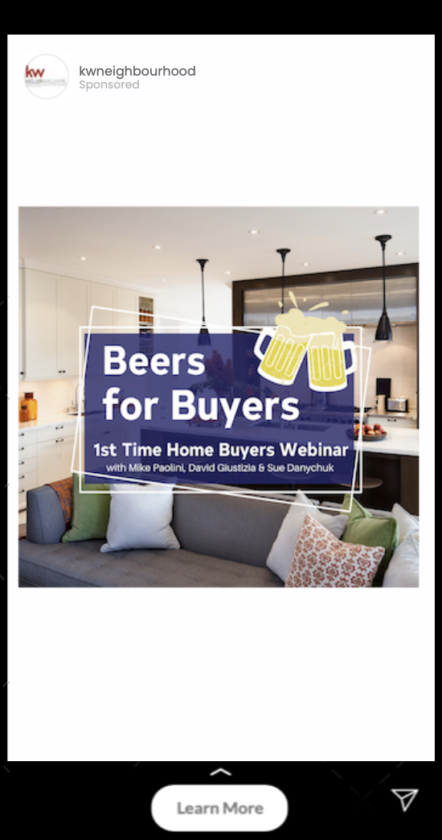
Instagram Marketing
Instagram: consistent posts across different platforms
Sponsored Posts Story Ads
“The number of shared videos on Instagram increases by 80% per year”
Promote Event - Workshops, webinars
(Websitebuilder)
Notes:
Similar to Facebook, Instagram is a great tool to reach a specific demographic and connect to numerous amounts of people!
Specifically with Instagram, there is the opportunity of creative freedom to help build the engagement of followers and even obtain quick and easy data.
According to Forbes “80% of Instagrammers follow at least one business profile”
Considering this percentage, the more individuals following the more reach to clients can be obtained as well as the opportunity to create strong word of mouth

Slide 21
Public Relation
Events
Online Workshops & Webinars
1
2
3
Acquire new customers
Trust & Reliability
Agents Training
Demonstrating local market knowledge and real estate expertise to a live audience
Home buyers want their agents are knowledgeable in real estate.
Agents training and career development.
Notes:
Due to the current pandemic, the usage of smartphones alone has increased by 25% to a totalled average of approximately 7 hours per day according to the Washington post.
For this reason, to further our implementation of strengthening Keller Williams online presence, our team wants to incorporate and continue to promote the use of online workshops and webinars that consist of educational topics or even virtual tours.
This will not only further the success of agents but also helps create a customer centric experience making the customer feel more comfortable with the company and specifically agent
When hosting such events, attendees will be required to provide their email in order to take part which will give Keller Williams an added benefit of being able to remain connected with these individuals and use their emails for further promotions

Slide 22


KWNR Wallet
Value-added Plans: win-win programs
Provide clients credits to use partners services
KWNR Golden Wallet
KWNR Platinum Wallet
Top up $200, get total $500 credits
Use at movers and cleaning service partners
Top up $400, get $1,000 total credits
Use at movers, cleaning service partners and house repair / renovate service partners
Notes:
SOPHIE

Slide 23
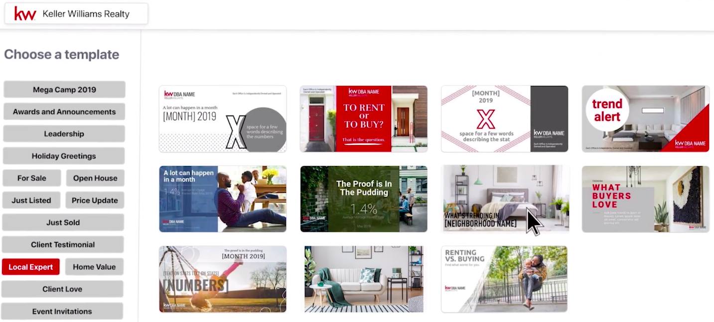
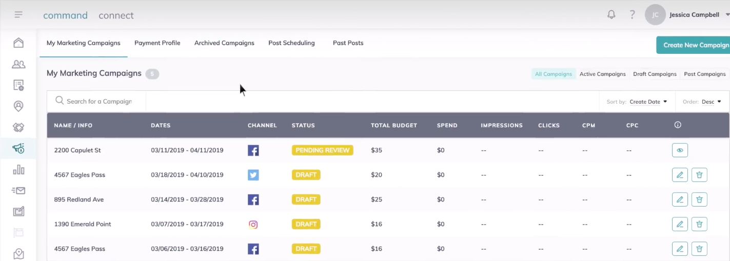
Command - Keller Williams CRM system
Manage leads and build relationships with clients
Design and run ads on various platforms
Customizes digital marketing materials
Create & manage effective campaigns across social media channels
Notes:
COCO
We know that Keller Williams does have its own CRM system, Command, to manages leads and build relationships with clients. However, Command is more than just a CRM system, it allows agents to design and run advertisements on various social media platforms.
All the marketing plans we mentioned above can be designed, run, and manage in one single application – Command. As teamwork has become more critical than ever to display resilience and creativity in response to the global pandemic, economic uncertainty, and rising technology costs, Keller Williams agents need to work as teams and use Command as a powerful marketing tool, rather than striving as independent individuals.

Slide 24
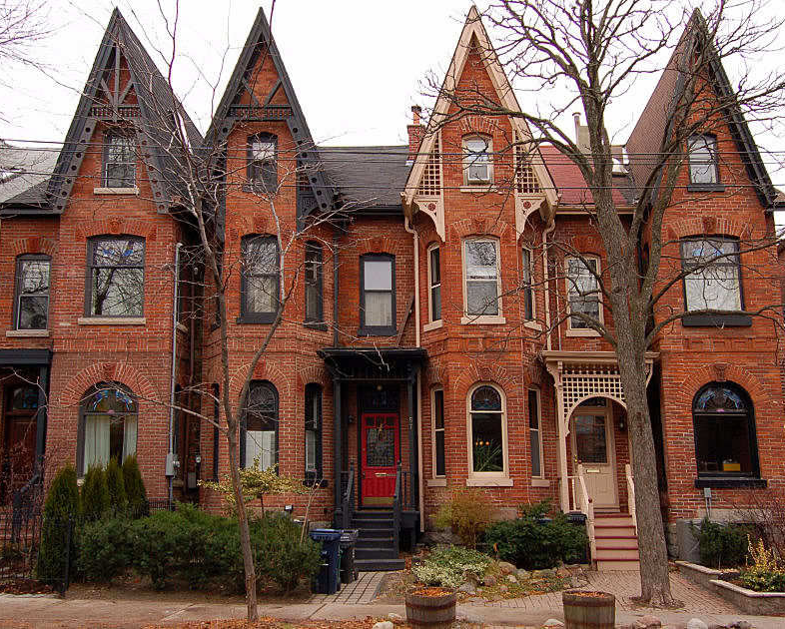
The
Close
05

Slide 25
Performance Measurements & KPIs
1
2
3
4
5
6
Agent Growth
+200 (Within 2yrs)
Social Media Followers
+180-300
Keyword Performance
Quality score 7-10
Home Buyer Growth
+1320 (Within 2yrs)
Social Media Interaction
+ 35%
Website Traffic
+30%
Notes:
SABRINA
So we’ve explained our team’s suggested objectives, why we choose them, and even how they’ll be implemented.
Though, in order to ensure the plan remains successful once implemented, we have set specific indicators that can help determine if the plan is on track.
The numbers shown are based on our team’s minimum expectation
For example, within a 2 year span we expect there to be an additional 200 agents within the Keller Williams Neighbourhood Realty
This is based on our expected home buyer growth as well as the generated brand awareness created from our marketing plan.

Slide 26
Sales Forecast
60 new agents/ year
64/30/6% Split
80
Goal: 200 Agents in 2 years
30% goes to market center
Revenue |  |  |  | 2021 |  | 2022
Sales
Package Plan |  |  | $ | 159,600.00 | $ | 162,951.00
Commission |  |  | $ | 5,685,750.00 | $ | 6,722,100.00
Net Income |  |  | $ | 584,007.08 | $ | 1,133,213.79
Notes:
SOPHIE
We expected each new agent should have an average of 3 clients in a year, and an experienced agent is expected to reach 12 clients per year. Therefore, as Keller Williams currently has 80 agents, the company should increase 60 agents per year, reaching the goal, 200 agents.
When looking at the commission structure of Keller Williams, it is on a 64/30/6% split. 64% of the commission goes to the agent, 30% goes to the market center, and 6% goes to KWRI.
The average price among all the housing types in 2021 is $665,000 and expected to grow 2.5%, which is $679,000 in 2022. Keller Williams’ commission rates is 5%. Within 5% commissions, 2.5% goes to the buying agents, and 2.5% goes to the selling agents. Therefore, with the average $656,000 housing price, each commission will be $16,625.

Slide 27
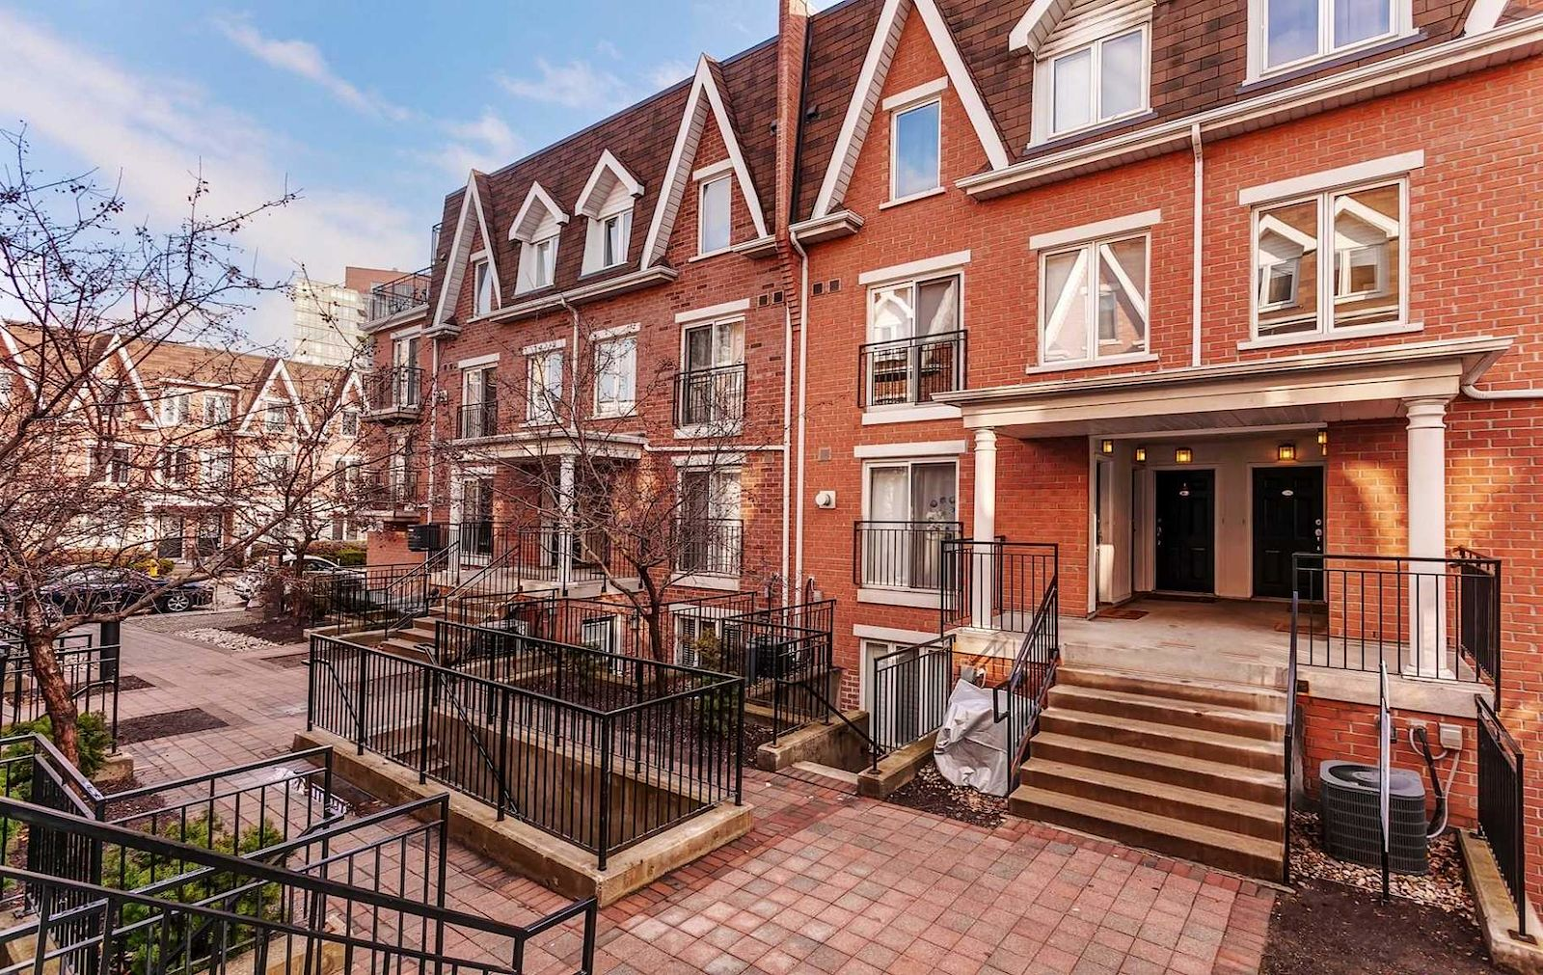
The Fine Print
06

Slide 28
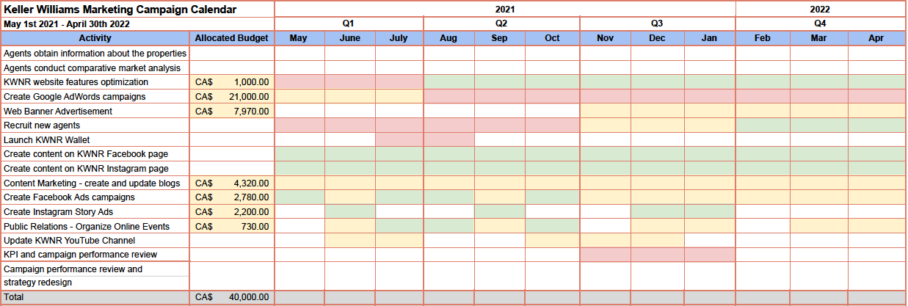
Gantt Chart
High Priority
Medium Priority
Low Priority
Notes:
COCO
The execution gantt chart is broken down into 4 distinct quarters with the 12 months campaign from May 2021 to May 2022. Budget and timeframe of important activities, including website features optimization, Google AdWords campaigns, Web banner advertisement, content marketing, FB and Ins ads, and public relation are shown in the chart
Due to the fact that Google AdWords campaign is our biggest focus as 97% of all home buyers search info using online website, its budget accounts for half of the 40k marketing budget and it will run throughout the 12-month period. Website features optimization will also run for 12 months, but most activities, including listing search function, updating blogs, testimonial, are focused on the first quarter. FB and Ins ads campaigns will run bimonthly to promote bimonthly online events, while web banner advertisements will be rolled out in the fourth quarter of 2021 till the end of the first quarter of 2022, when the most number of homes are sold. Lastly, in content marketing, Keller Williams will keep updating weekly blogs and visual content during the 12-months duration.

Slide 29
Conclusion
Grow through recruitment
IMC to pivot to digital approach during COVID19
Net Profit in 2021 and 2022: $1.7 million
Notes:
JORDYN
At the end discussion: How to attract agents - financial incentives - tangible/intangible - more than other competitors - suggestion the wolfs to think about this
Personal reputation, WOM, relationship with clients
To summarize, Keller Williams is a real estate brokerage well situated to grow their business. Seven Wonder Consulting agency has created a strategic marketing plan to help Keller Williams expand their operation and stay competitive. By growing their agent roster from 80 to 200, Keller Williams will increase profit to ensure their future success. Future success will also be determined by how well these agents' talents are leveraged, this can be achieved by the incorporation of the KW Wallet program. The goal will also be supported by an IMC that focuses on recruitment and building the Keller Williams brand. Major activities that need to be completed are a google ads campaign, updated web content to increase SEO, and new banner ads to target homebuyers and new agents.
The Canadian housing market is an incredibly dynamic environment and long term success is never guaranteed. By successfully incorporating a strengthened digital IMC into Keller Williams marketing efforts Seventh Wonder projects that in two years Keller Williams will meet its profit objectives of earning $5000 per home sold and total profit growth of $11.5 million
Emily Notes:
Go back to the objectives on page 11, this answers the questions.

Slide 30


Thank you for listening!
Do you have any questions?

